Slide 1
Data Base
Pavel Vrublevskij

Slide 2
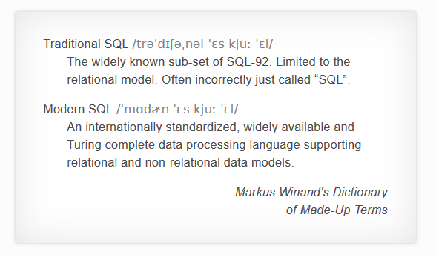
Blue Pill or Red Pill?

Slide 3
SQL commands categories
DDL(Data Definition Language)
DML(Data Manipulation Language)
DCL(Data Control Language)
TCL(transaction Control Language)

Slide 4
DDL(Data Definition Language)
DDL or Data Definition Language actually consists of the SQL commands that can be used to define the database schema. It simply deals with descriptions of the database schema and is used to create and modify the structure of database objects in database.
CREATE – is used to create the database or its objects (like table, index, function, views, store procedure and triggers).
DROP – is used to delete objects from the database.
ALTER-is used to alter the structure of the database.
TRUNCATE–is used to remove all records from a table, including all spaces allocated for the records are removed.
COMMENT –is used to add comments to the data dictionary.
RENAME –is used to rename an object existing in the database.

Slide 5
DML(Data Manipulation Language)
The SQL commands that deals with the manipulation of data present in database belong to DML or Data Manipulation Language and this includes most of the SQL statements.
SELECT – is used to retrieve data from the a database.
INSERT – is used to insert data into a table.
UPDATE – is used to update existing data within a table.
DELETE – is used to delete records from a database table.

Slide 6
DCL(Data Control Language)
DCL includes commands such as GRANT and REVOKE which mainly deals with the rights, permissions and other controls of the database system.
GRANT-gives user’s access privileges to database.
REVOKE-withdraw user’s access privileges given by using the GRANT command.

Slide 7
TCL(transaction Control Language)
TCL commands deals with the transaction within the database.
COMMIT– commits a Transaction.
ROLLBACK– rollbacks a transaction in case of any error occurs.
SAVEPOINT–sets a savepoint within a transaction.
SET TRANSACTION–specify characteristics for the transaction.

Slide 8

Let‘s test your knowledge

Slide 9
CTE (Common Table Expressions)
The Common Table Expressions (CTE) were introduced into standard SQL in order to simplify various classes of SQL Queries for which a derived table was just unsuitable. CTE was introduced in SQL Server 2005, the common table expression (CTE) is a temporary named result set that you can reference within a SELECT, INSERT, UPDATE, or DELETE statement. You can also use a CTE in a CREATE a view, as part of the view’s SELECT query. In addition, as of SQL Server 2008, you can add a CTE to the new MERGE statement.

Slide 10
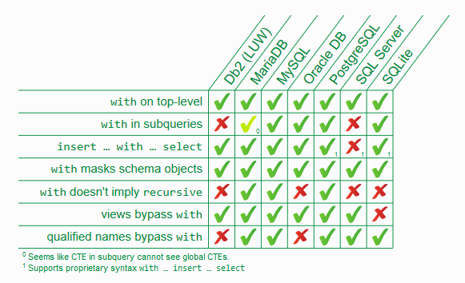

Slide 11
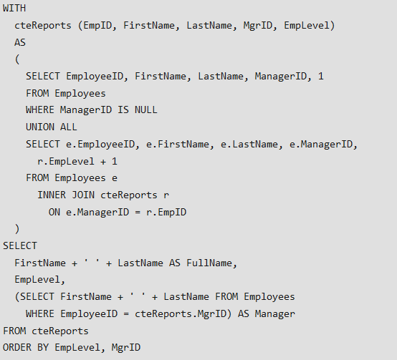
CTE Example

Slide 12
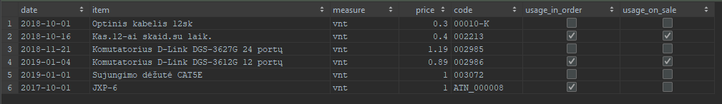
WITH __data(date, item, measure, price, code, usage_in_order, usage_on_sale) AS ( VALUES ('2018-10-01', 'Optinis kabelis 12sk', 'vnt', 0.30, '00010-K', FALSE, FALSE), ('2018-10-16', 'Kas.12-ai skaid.su laik.', 'vnt', 0.40, '002213', TRUE, TRUE), ('2018-11-21', 'Komutatorius D-Link DGS-3627G 24 portų', 'vnt', 1.19, '002985', FALSE, FALSE), ('2019-01-04', 'Komutatorius D-Link DGS-3612G 12 portų', 'vnt', 0.89, '002986', TRUE, TRUE), ('2019-01-01', 'Sujungimo dėžutė CAT5E', 'vnt', 1.00, '003072', FALSE, FALSE), ('2017-10-01', 'JXP-6', 'vnt', 1.00, 'ATN_000008', TRUE, FALSE) ) SELECT * FROM __data; /* 1. Turima CTE (Common Table Expressions) bloką paversti į lentelę 2. Pateikti medžiagų sąrašą (pavadinimas, suma), kurie naudojami pardavimuose 3. Pateikti sąrašą D-Link komutatorių (pavadinimas, suma), kurie naudojami užsakymuose 4. Pateikti medžiagų sąrašą sudaryta 2018-ais metais,
nurodant atskirose stulpeliuose metai, mėnuo, data, pavadinimas, suma 5*. Pateikti sumą stulpeliuose pagal: 1as stulpelis: užsakymai 2as stulpelis: pardavimai 3as stulpelis: ne naudojami užsakymuose ir pardavimuose *Sprendimas naudoti: <column> FILTER (WHERE <column>) */

